Slide 1
GGPLOT IN PYTHON
-By Sarah Masud

Slide 2
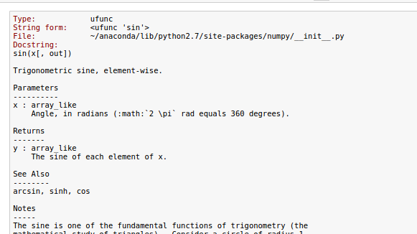
INTRODUCTION:
This ppt will cover the basic functions of ggplot in python. This will help beginners to understand what the functions mean and how to use them.
SELF HELP:
If you don’t remember the function or wish to know more about it, you can use the help function in python by simply typing the function name followed by a ?
EXAMPLE:
INPUT:
OUTPUT:

Slide 3
INSTALL ggplot UNDER PYTHON:
PREREQUISITES INSTALLED:
pip
easy install
matplotlib
pandas
numpy
scipy
statmodels
FOR LINUX
Method 1: pip install ggplot
Method 2: pip install git+git://github.com/yhat/ggplot.git

Slide 4
SOURCE OF DATA:
Big Diamonds data set is used through the presentation. You can download the data set from:
https://github.com/SolomonMg/diamonds-data
HOW TO OBTAIN THE CSV:
METHOD 1: Read the RDA file in R and writeback as CSV.
METHOD 2: Use rpy2.

Slide 5
WHAT IS ggplot?
Created by H. Wickman, ggplot provides an easy interface to generate state of art visualizations.
Written originally for R, its success enabled it be used for Python as well.
COMPONENTS OF ggplot:
ggplot API- Used to implement the plots.
Data- Uses data as Data Frames as in pandas.
Aesthetics- How the axes and theme looks.
Layer- what information is annotated on top of basic plot.

Slide 6
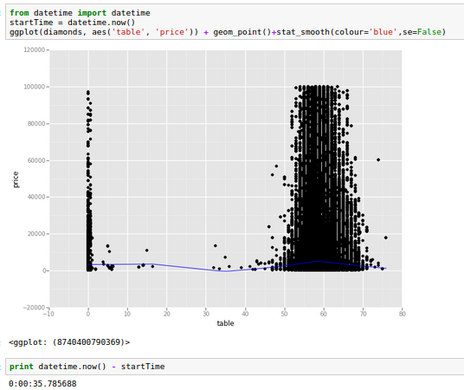
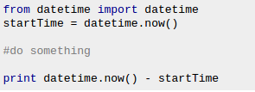
TIME TAKEN TO EXECUTE A FUNCTION:
Source: http://stackoverflow.com/questions/6786990/find-out-time-it-took-for-a-python-script-to-complete-execution

Slide 7
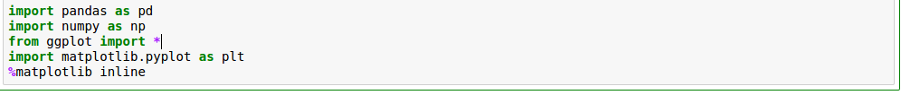
INPUT THE DATA:
Import necessary packages.
Read Data:

Slide 8
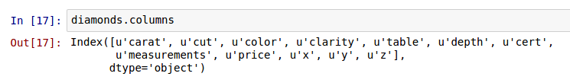
EXPLORE THE DATA:
len()- Number of rows in the dataset
2. column()- What are names of the columns.

Slide 9
WHAT DOES THE COLUMNS CONTAIN:
Carat- Weight of the diamond (1 carat=0.2g)
Cut- Quality of cut
Color- Color of diamond (J-worst D-best)
Clarity- A measure of how clear the diamond is.
Cert- The level of certification granted.
x- Length in mm.
y- Breadth in mm.
z- Height in mm.
Measurement- Volume in terms of x*y*z.
Table- Width of top of diamond relative to widest point.
Depth- Numerically = (2*z) /(x+y)

Slide 10
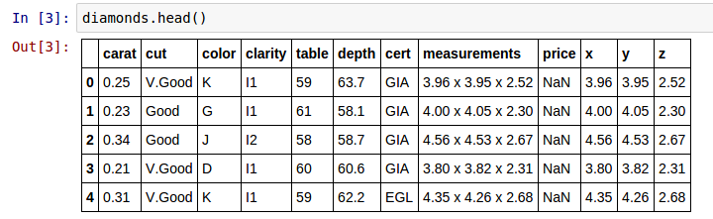
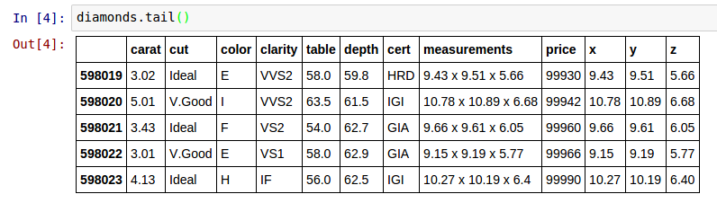
3. head()/tail()- To know the first few & last few values, respectively.
NOTE: The dataset contains both quantitative(numeric)
and qualitative fields.

Slide 11
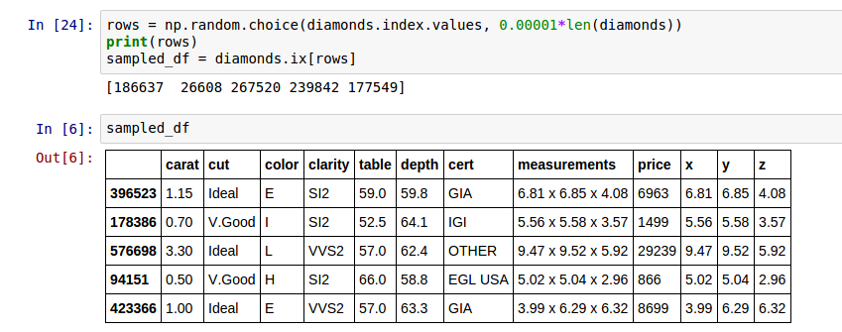
4. Random selection- To see data values at random.

Slide 12
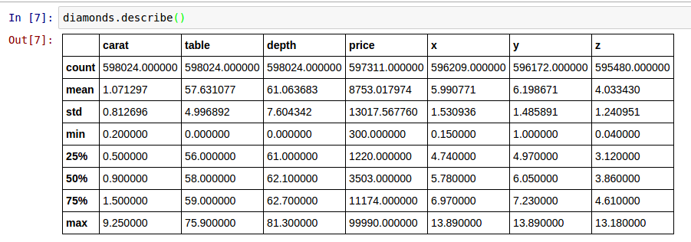
5. Describe()- Give the mathematical details of fields with numerical value.
NOTE: The mean of x,y are approximately same. Do diamonds have proportionate length/breadth?

Slide 13
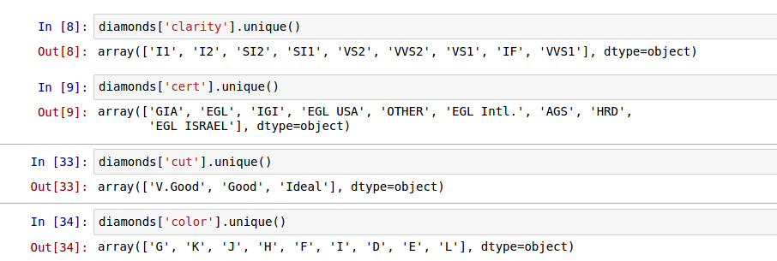
7. unique()- To know the unique(1 or many) values that make up the dataset.

Slide 14
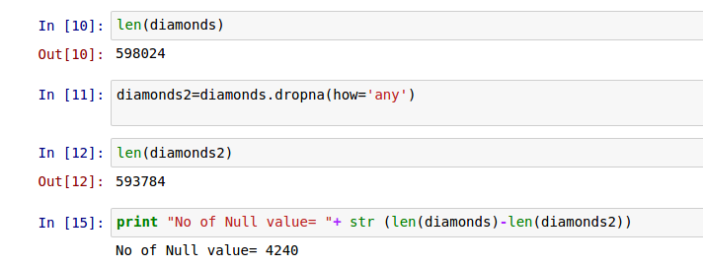
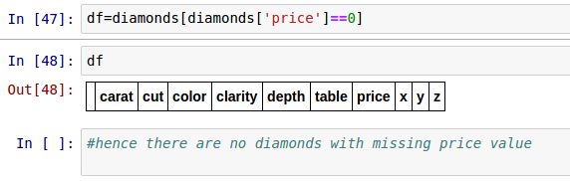
PREPARING DATA:
1.Check for null values.
2. Check for zero price values.

Slide 15
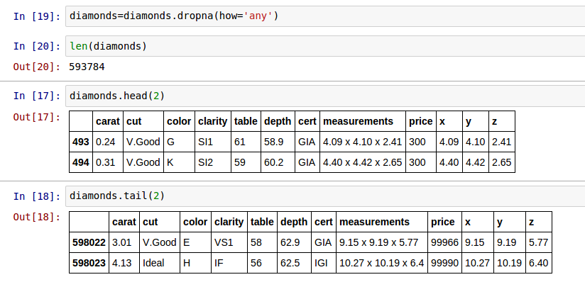
3. Obtain clean data set by removing null values.

Slide 16
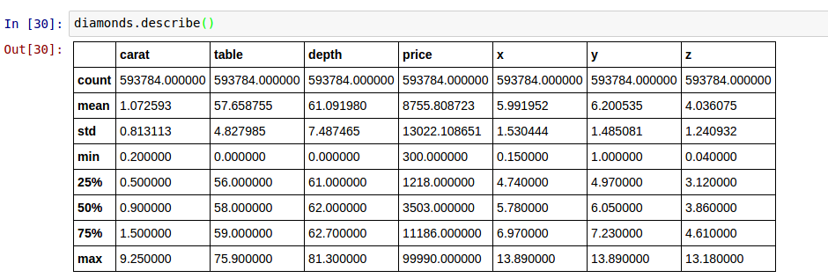
EVALUATION OF DATA:
New Statistical Information:

Slide 17
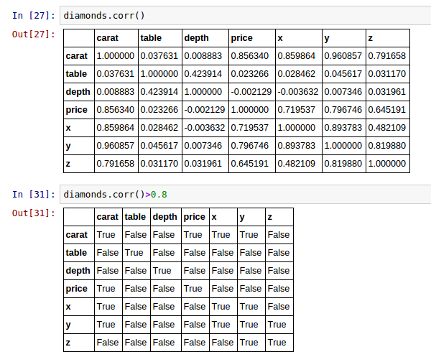
2. Correlations

Slide 18
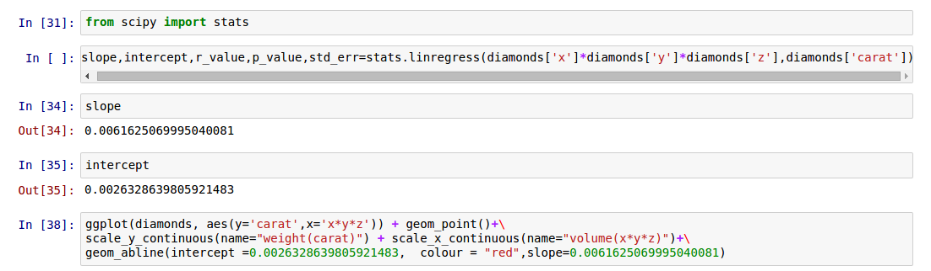
3. The plot of density of diamond
NOTE:
stat.lingress is used to calculate the components of the line of best fit of the form y=mx+c, where m=slope and c=y-intercept. The r_value is the regression coefficient, the p_value s a constant usually zero, while std_err is the error of estimation.
ggplot(dataset,aesthetics(y,x)- Gives us a blank coordinate system
geom_points- Plots the dataset on the blank plot.
scale_y/x_continous- Use to give name and range of the axis.
geom_abline- Draw a line of form y=mx+c.

Slide 19
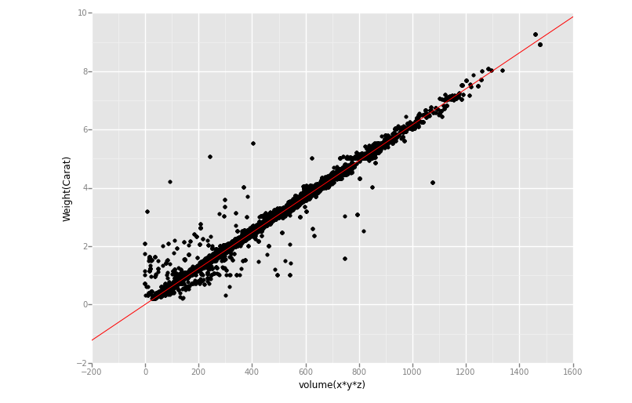
OUTPUT:
HOW IT WORKS:
ggplot is invoked.
A blank coordinate system with labeled axes is put up.
The points are plotted.
The axis redefined and cropped.
The line draw as another layer on top of the points.

Slide 20
PRICE EVALUATION:
Diamonds are expensive!
Let us try to map what factors make them so.

Slide 21
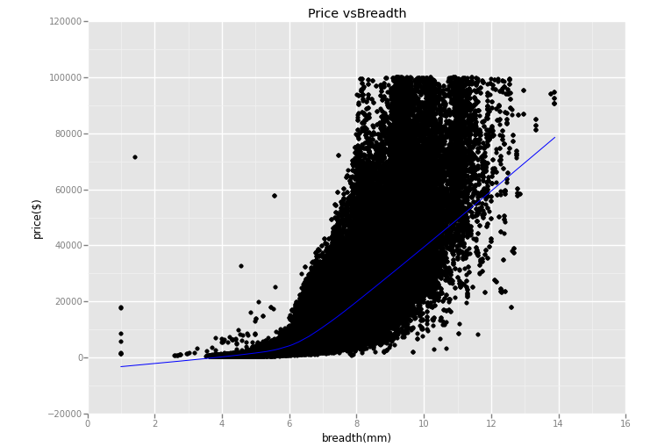
PRICE VS BREADTH
NOTE:
labs-use to label the graph and the axises.
x-lab and y-lab can also be separately used.
stats_smooth provides a mechanism to plot the line of regression and help determine the relation among the variants.

Slide 22
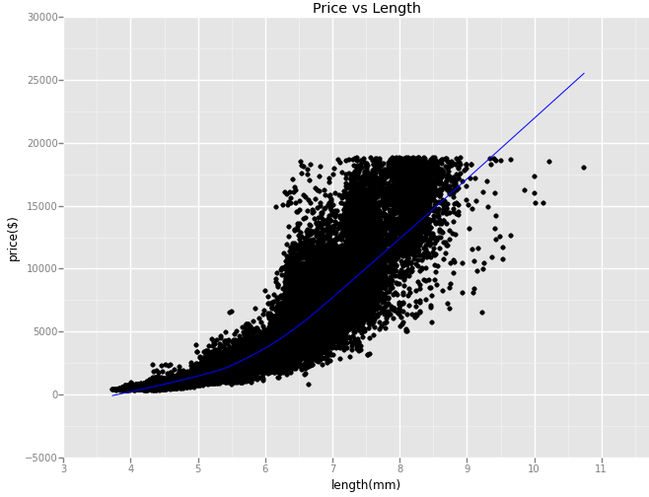
PRICE VS LENGTH

Slide 23
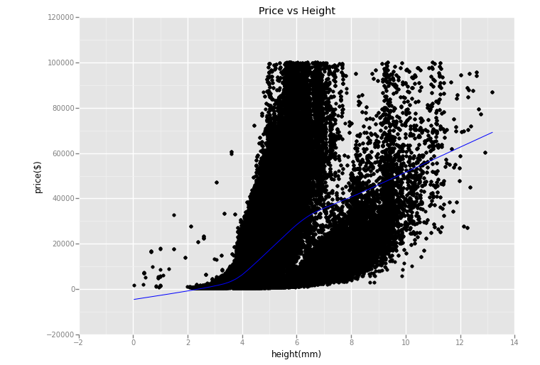
PRICE VS HEIGHT

Slide 24
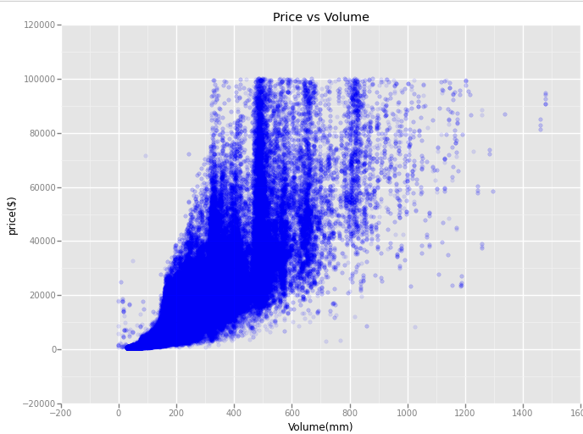
PRICE VS VOLUME
NOTE:
Geom-jitter
Over-plotting hides the number of points in each neighbourhood. We can reduce this problem by making the points more transparent.

Slide 25
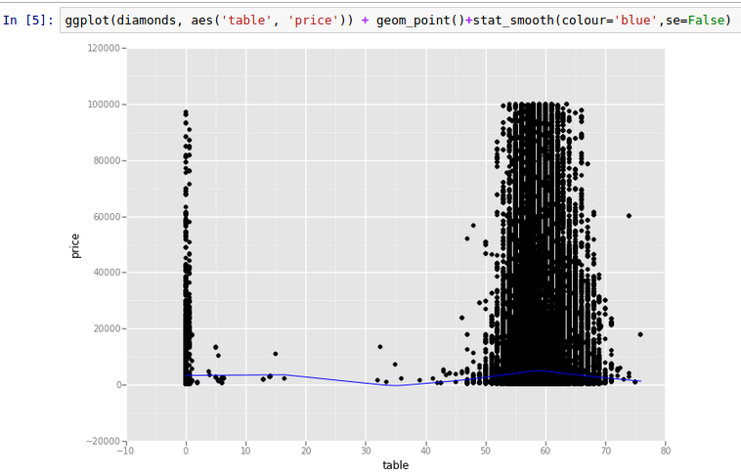
PRICE VS TABLE
NOTE:
A horizontal line of regression means that value of f(x) can be calculated without much consideration of the value of x.
Thus, price is not considerably affected by table and can be calculated without taking table into account.

Slide 26
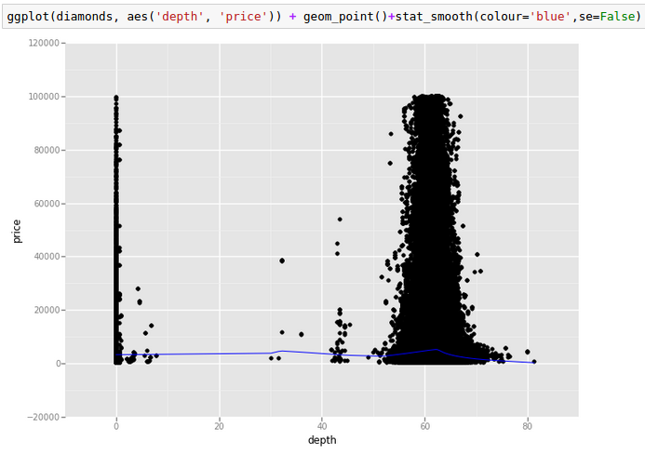
PRICE VS DEPTH

Slide 27
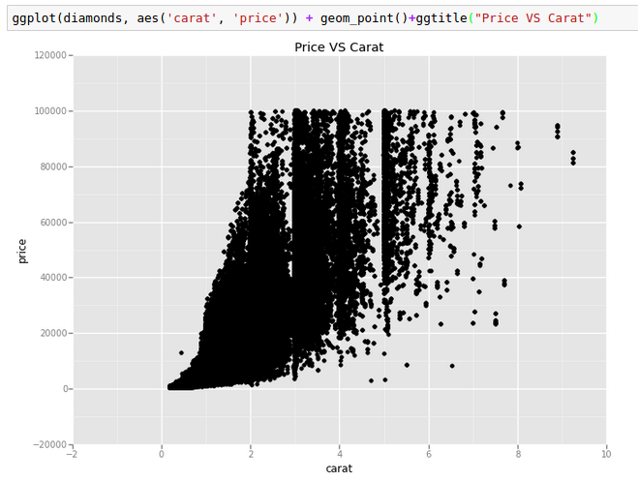
PRICE VS CARATS

Slide 28
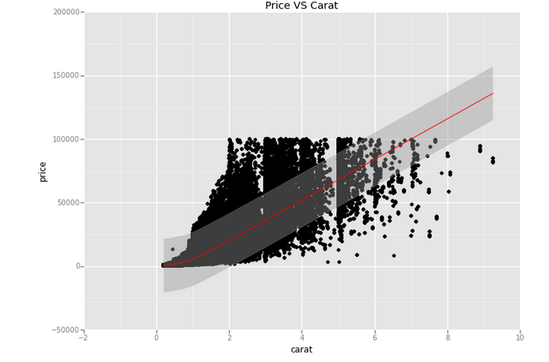
NOTE:
A quadratic line of regression signifies that value of price depends on the value of carat. But is only carat, lets see closely.

Slide 29

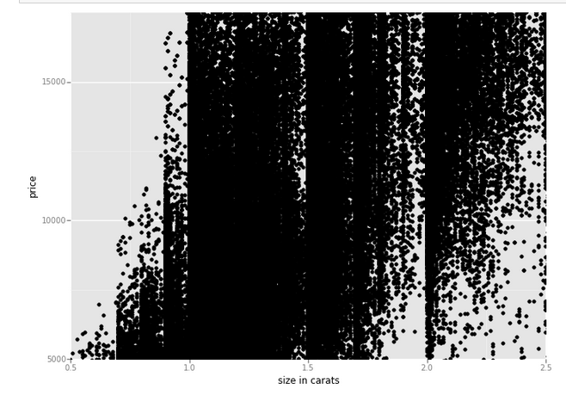
PRICE vs CARAT
NOTE:
Since the original Price VS carat graph was not providing us accurate information, we narrow down the scale to a particular section.
In the next slide we narrow it down further.

Slide 30
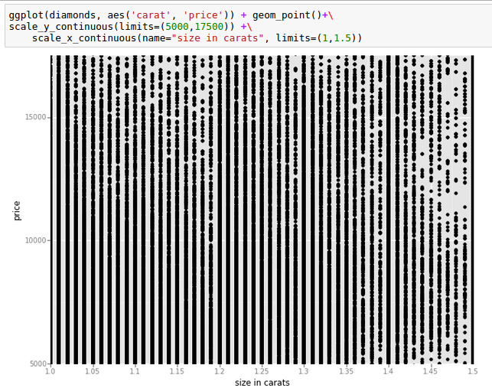
NOTE:
We see that the plot becomes vertical, i.e for the same value of carat we have varying price. Surely some other factor is controlling it.

Slide 31
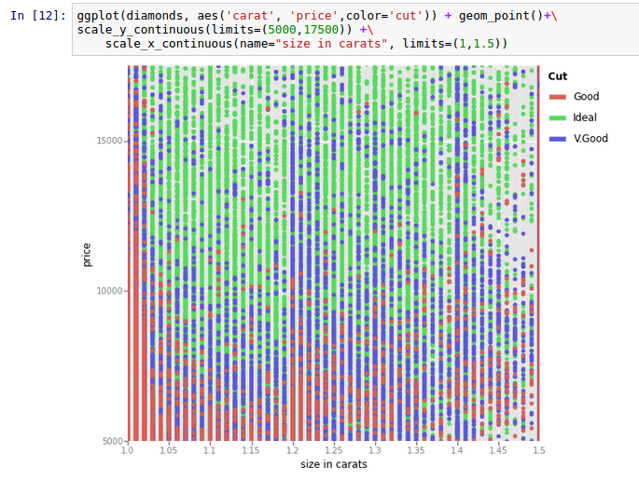
NOTE:
This is plotting the price with respect to the cut.
We see that for a given carat value the quality of changes the price.

Slide 32
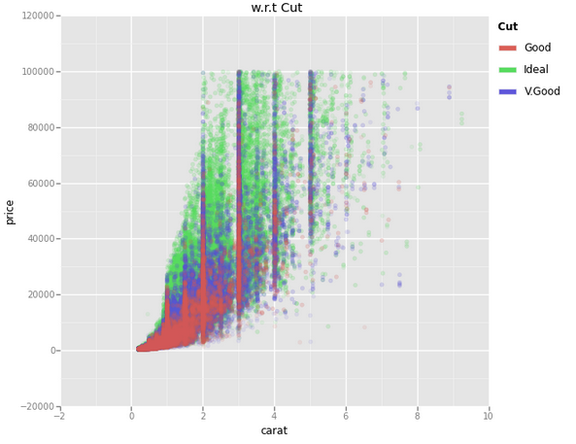
Differentiate price VS carat with respect to cut.

Slide 33
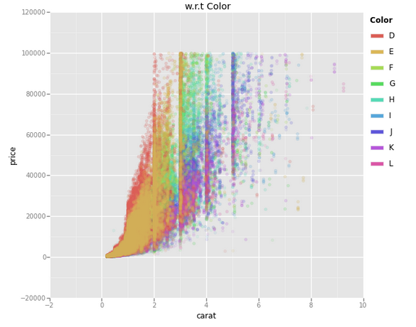
Differentiate price VS carat with respect to color.

Slide 34
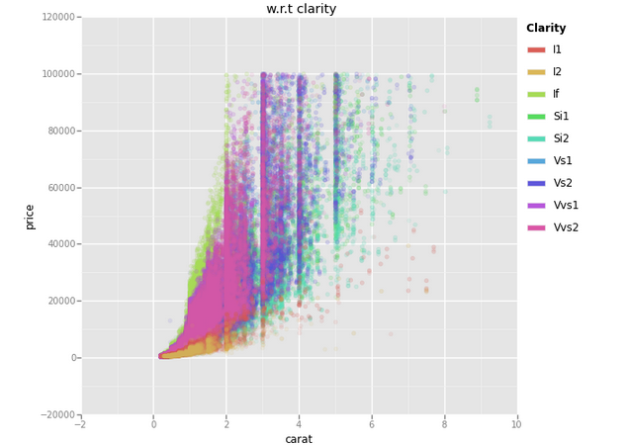
Differentiate price VS carat with respect to clarity.

Slide 35
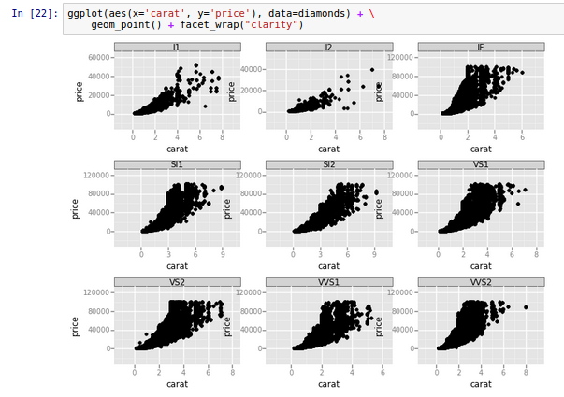
FACETS
NOTE:
Facets- It features the same set of data with respect to a given factor. This helps us determine which value of factor affects f(x) the most,

Slide 36
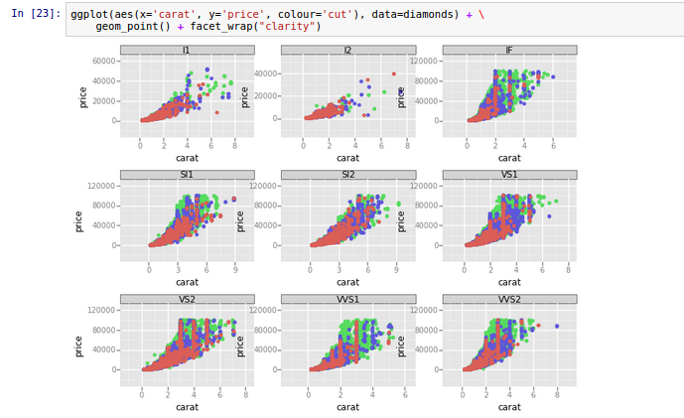
FACETS

Slide 37
FURTHER SOURCES:
This presentation is a part of the larger pool of learning resources provided by
DecisionStats.org
https://decisionstats.org
https://github.com/SolomonMg/diamonds-data
https://themessier.wordpress.com/2015/06/17/ggplot-in-python-part-1
http://nbviewer.ipython.org/gist/sara-02/d5a61234ef32e60bddda
http://nbviewer.ipython.org/gist/sara-02/d38da4a2023da169ac13
https://gist.github.com/sara-02/4eb520fd1b82521e8a11
CITATION:
http://ggplot.yhathq.com/
https://github.com/yhat/ggplot
FOR QUERIES:
info@decisionstats.org
sarahmasud02@gmail.com

Slide 38
THANK YOU

